Slide 1
TOPIC ONE.
Design and implementation of a discipline management application in a school establishment.

Slide 2
GROUP MEMBERS.
NKEM STEVE BERTRAND
TCHOULA LESLEY BRANDON NGATCHU
MUDOH DENZEL MUCHOK
AUSTIN ELONGO
NKWAKAP BRIGHT

Slide 3
PLAN.
Introduction
Objectives
Functional And Non-Functional Requirement.

Slide 4
Objectives.
The objectives for the design and implementation of a discipline management application in a school establishment are:

Slide 5
Continue……..
Implement an incident reporting system for efficient documentation and analysis of disciplinary issues, allowing administrators to identify pattern and trends for informed decision-making.
Develop a user- interface to enhance the application for administrators and teachers.
Implement a real time messaging system to enable communication between teachers and student and administrators.
Provides a notification system to alert administrators about disciplinary incident and updates.

Slide 6
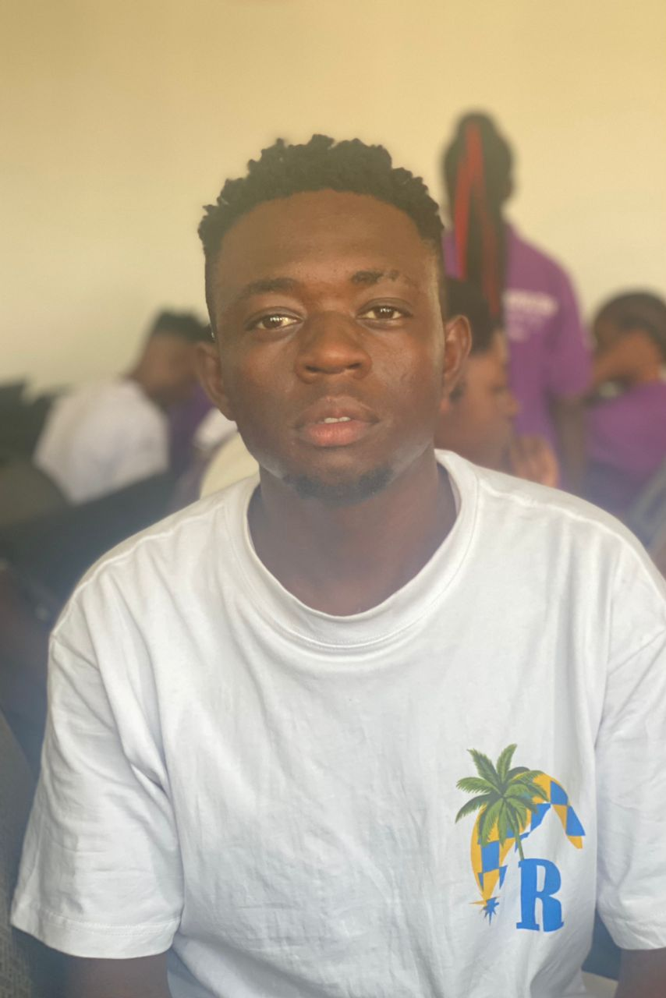

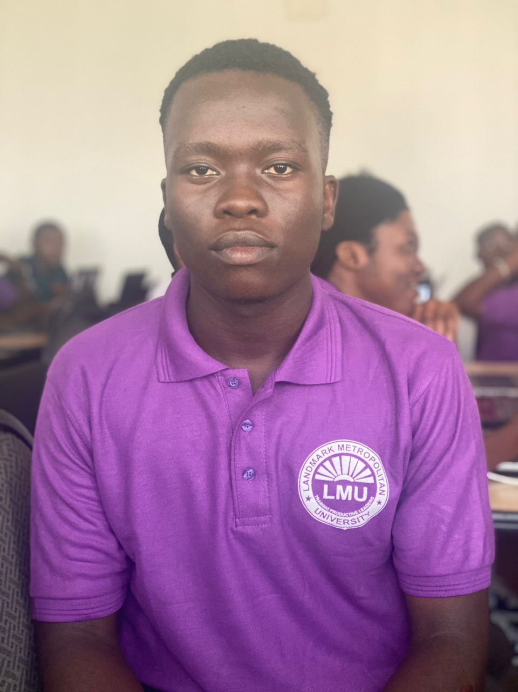

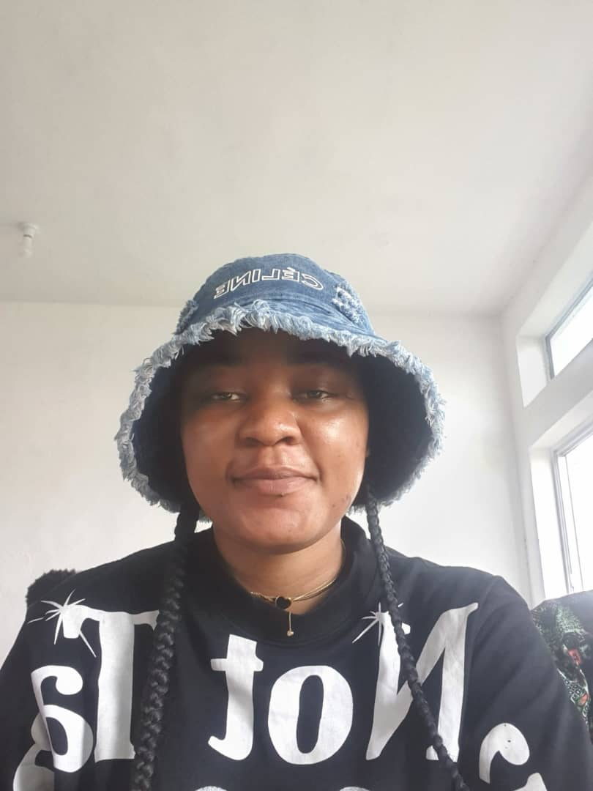
GROUP MEMBERS AND ROLES.
TCHOULA LESLEY
BRANDON NGATCHU
MUDOH DENZEL
MUCHOK
AUSTIN ELONGO
NKWAKAP BRIGHT
NKEM STEVE BERTRAND
Project Analyst
and PowerPoint
designer.
System analyst
Head of group
and supervisor
ui/ux engineer
Video grapher

Slide 7
FUNCTIONAL REQUIREMENTS.
The functional requirement of this system are:
The system should be able to allow Student information to be managed within the frame of the system.
The system will be able to allow Incident reporting by teachers, staffs and order administration within a landmark university.
This system will be able to grand Communication within the system.
The system will track progress on disciplinary task assign by the disciplinary council.

Slide 8
NON-FUNTIONAL REQUIREMENTS.
The system will response to request fast.
The system will always be accessible to the users at any instant
Some information will not be visible to teachers, only staffs will be allowed.
Only student and staffs of landmark will be accessible to this system.

Slide 9
Lifecycle.
Security
Conception and planning
Requirements analysis
System design
Implementation
Testing
Deployment
Operation Maintenance

Slide 10
Business opportunities.
Sale of customized versions to specific institutions.
Subscription of institution to un-customized version of the application(monthly/yearly).

Slide 11
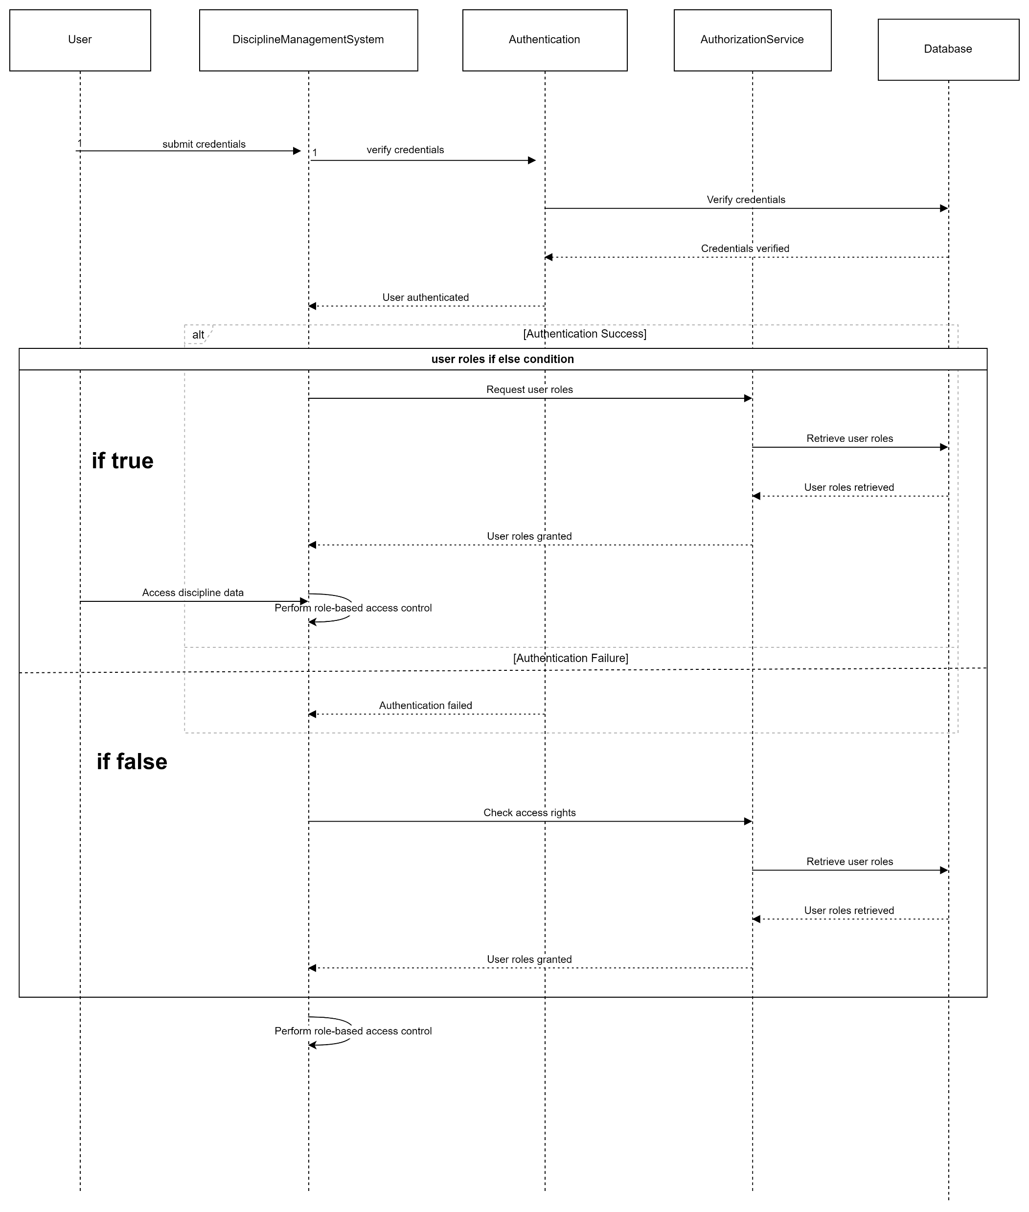
Sequence Diagram for Role Based Access Control.

Slide 12
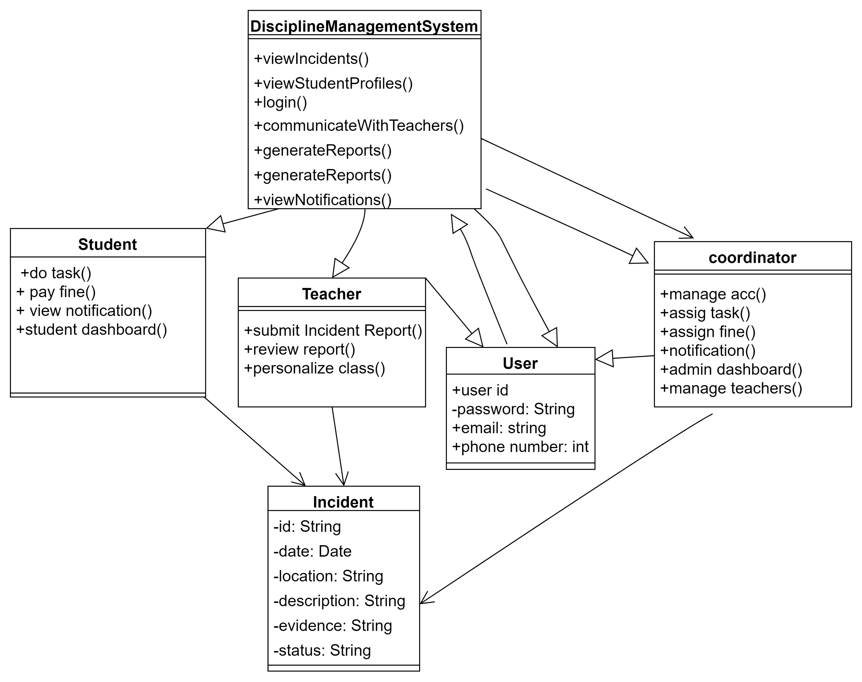
CLASS DIAGRAM.

Slide 13
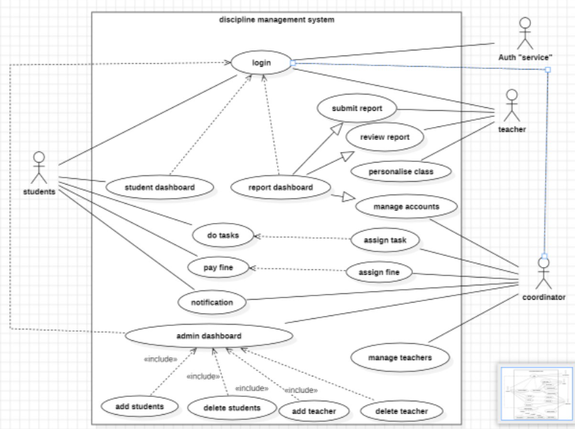
Use case diagram

Slide 14
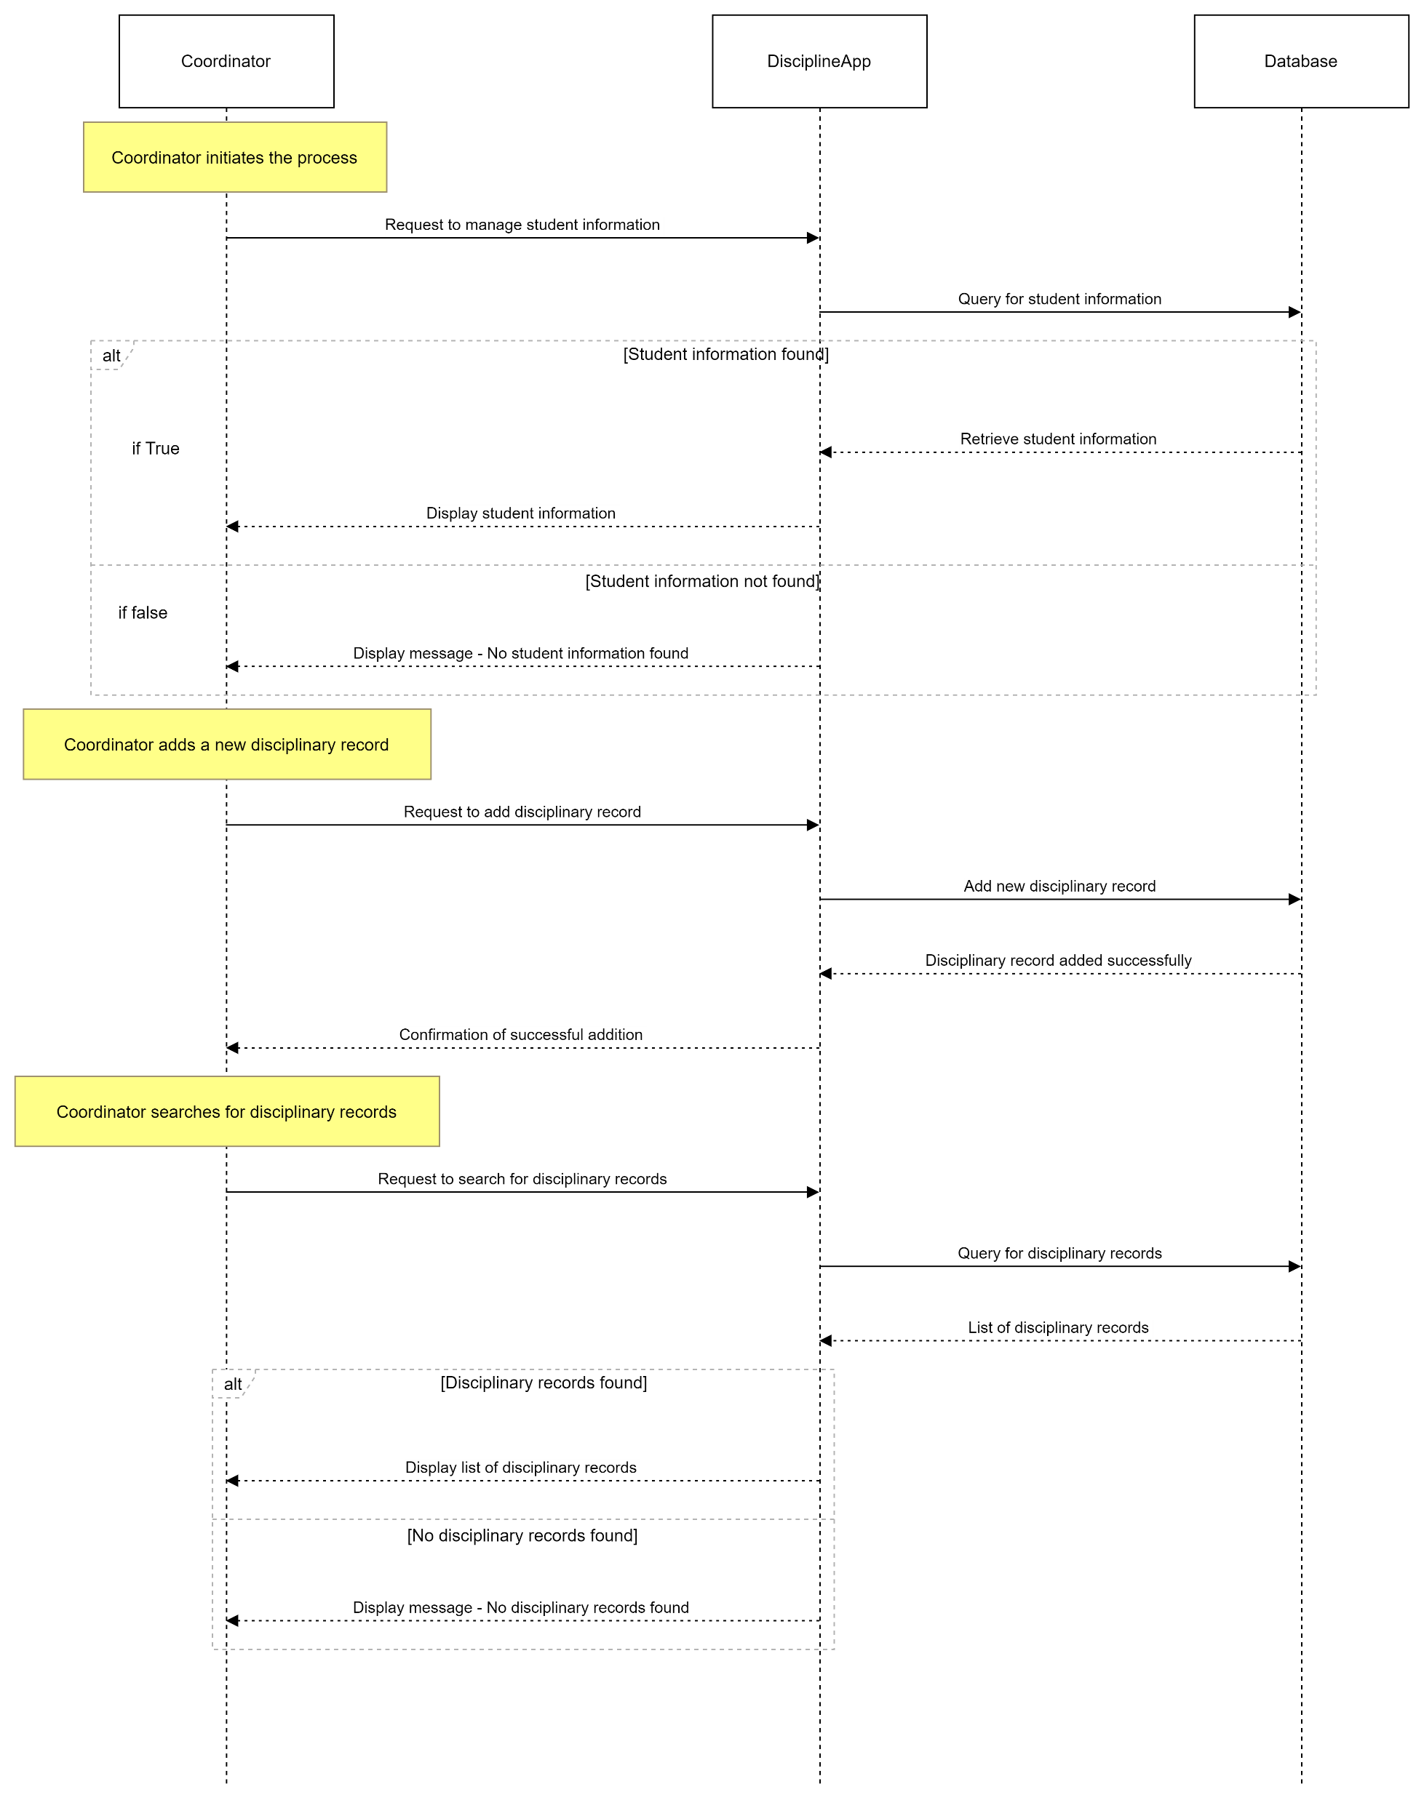
Student information management.

Slide 15
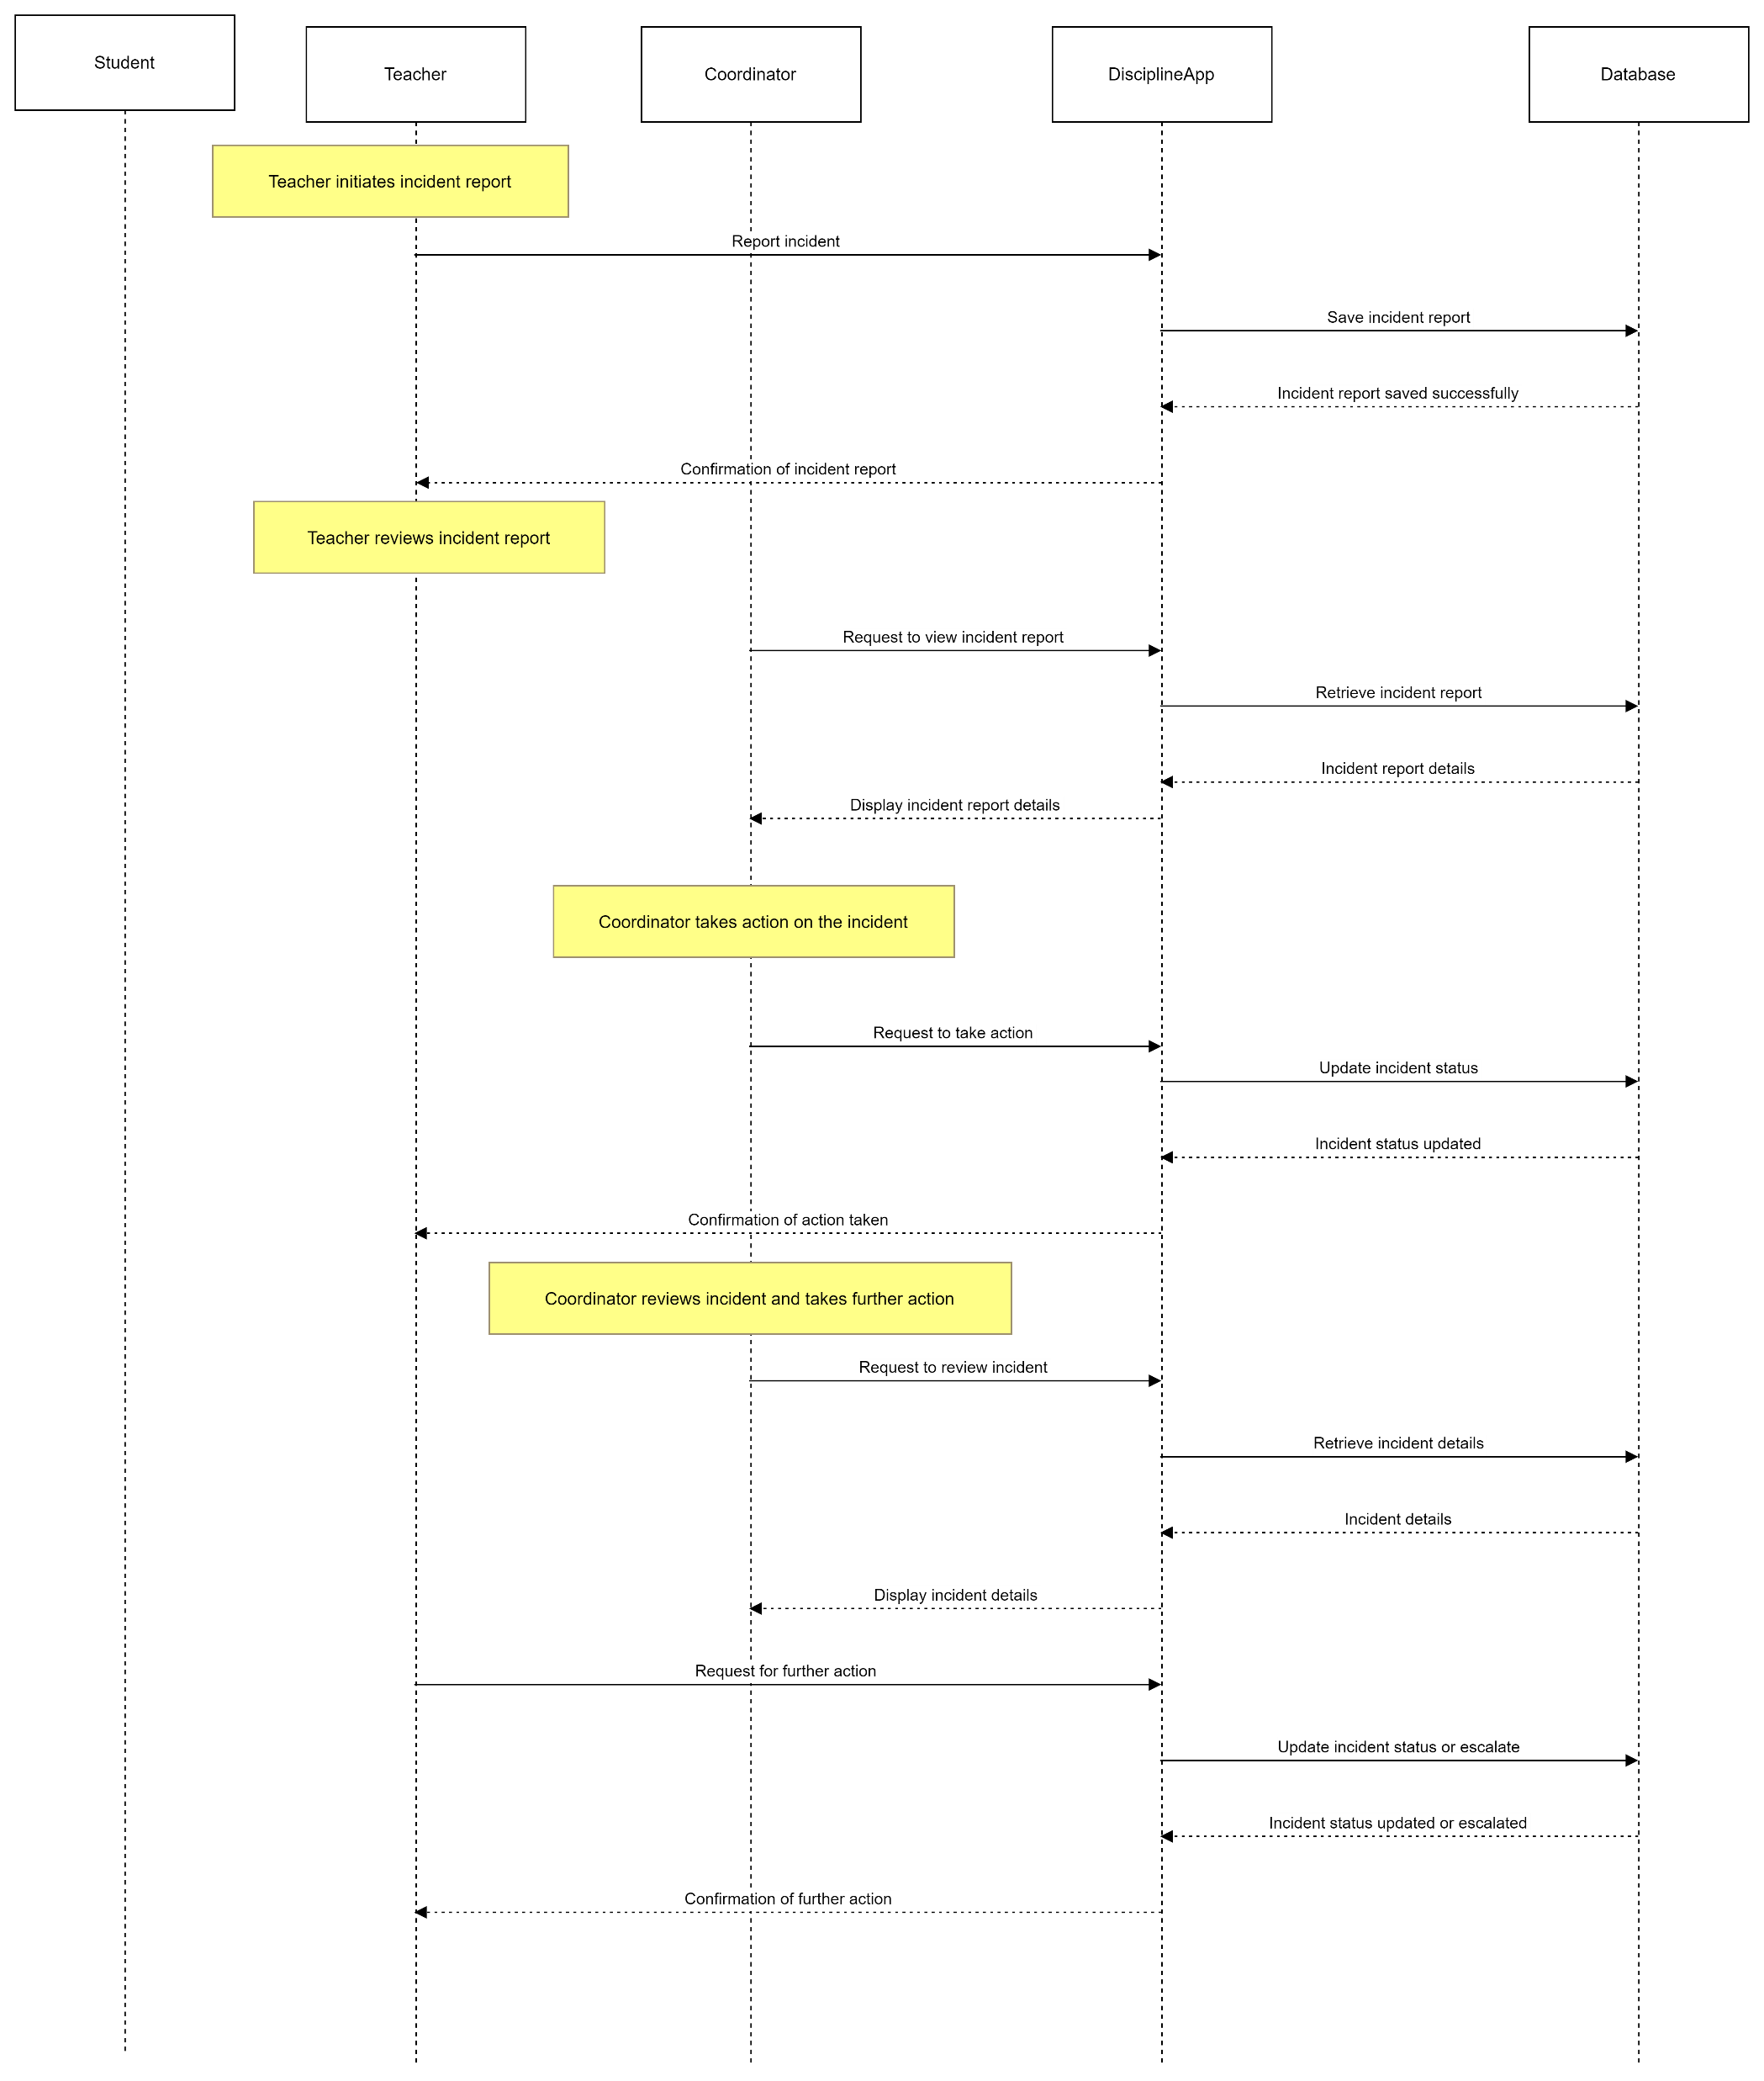
Incident reporting.

Slide 16
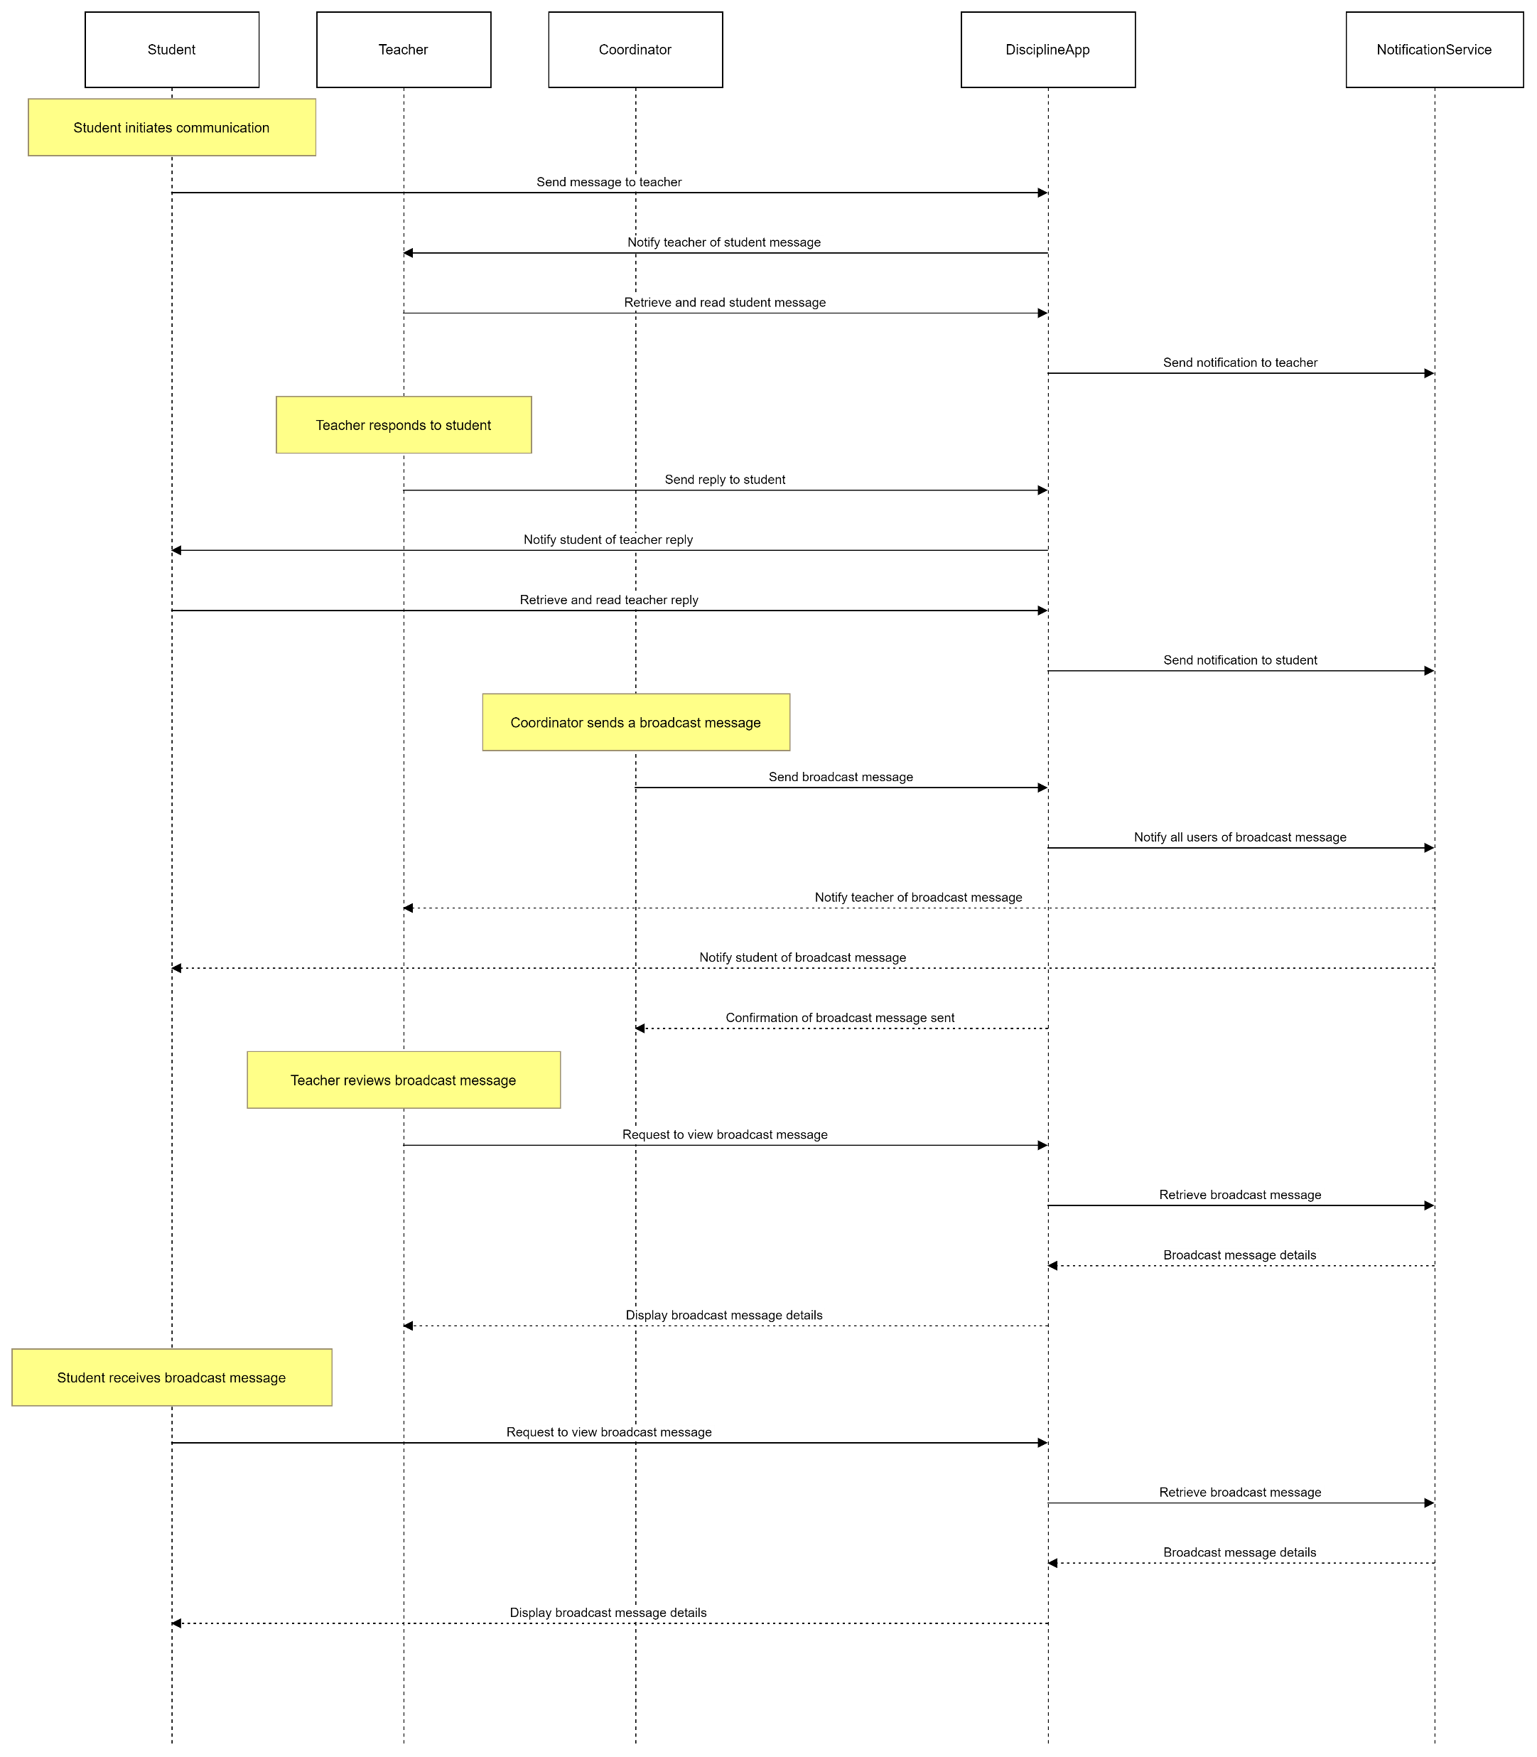
Communication system.

Slide 17
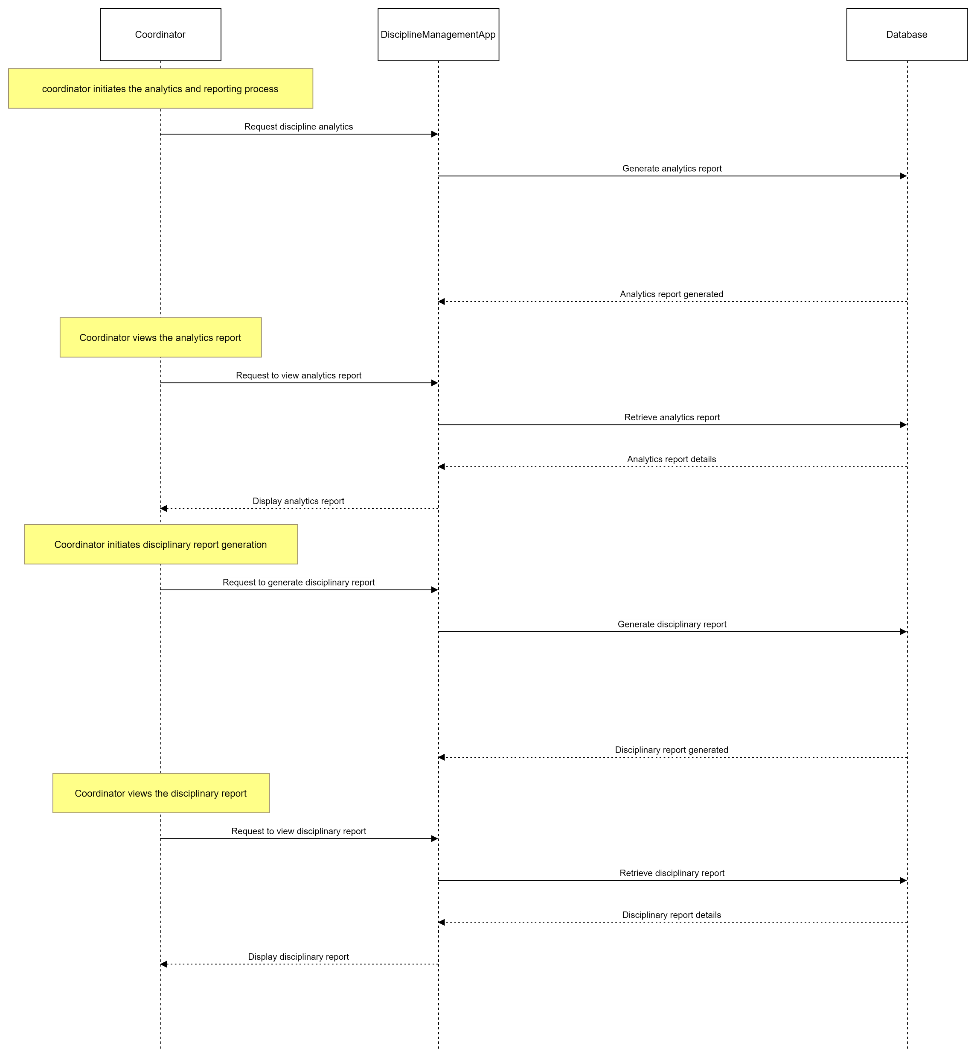
Analytic and reporting.

Slide 18
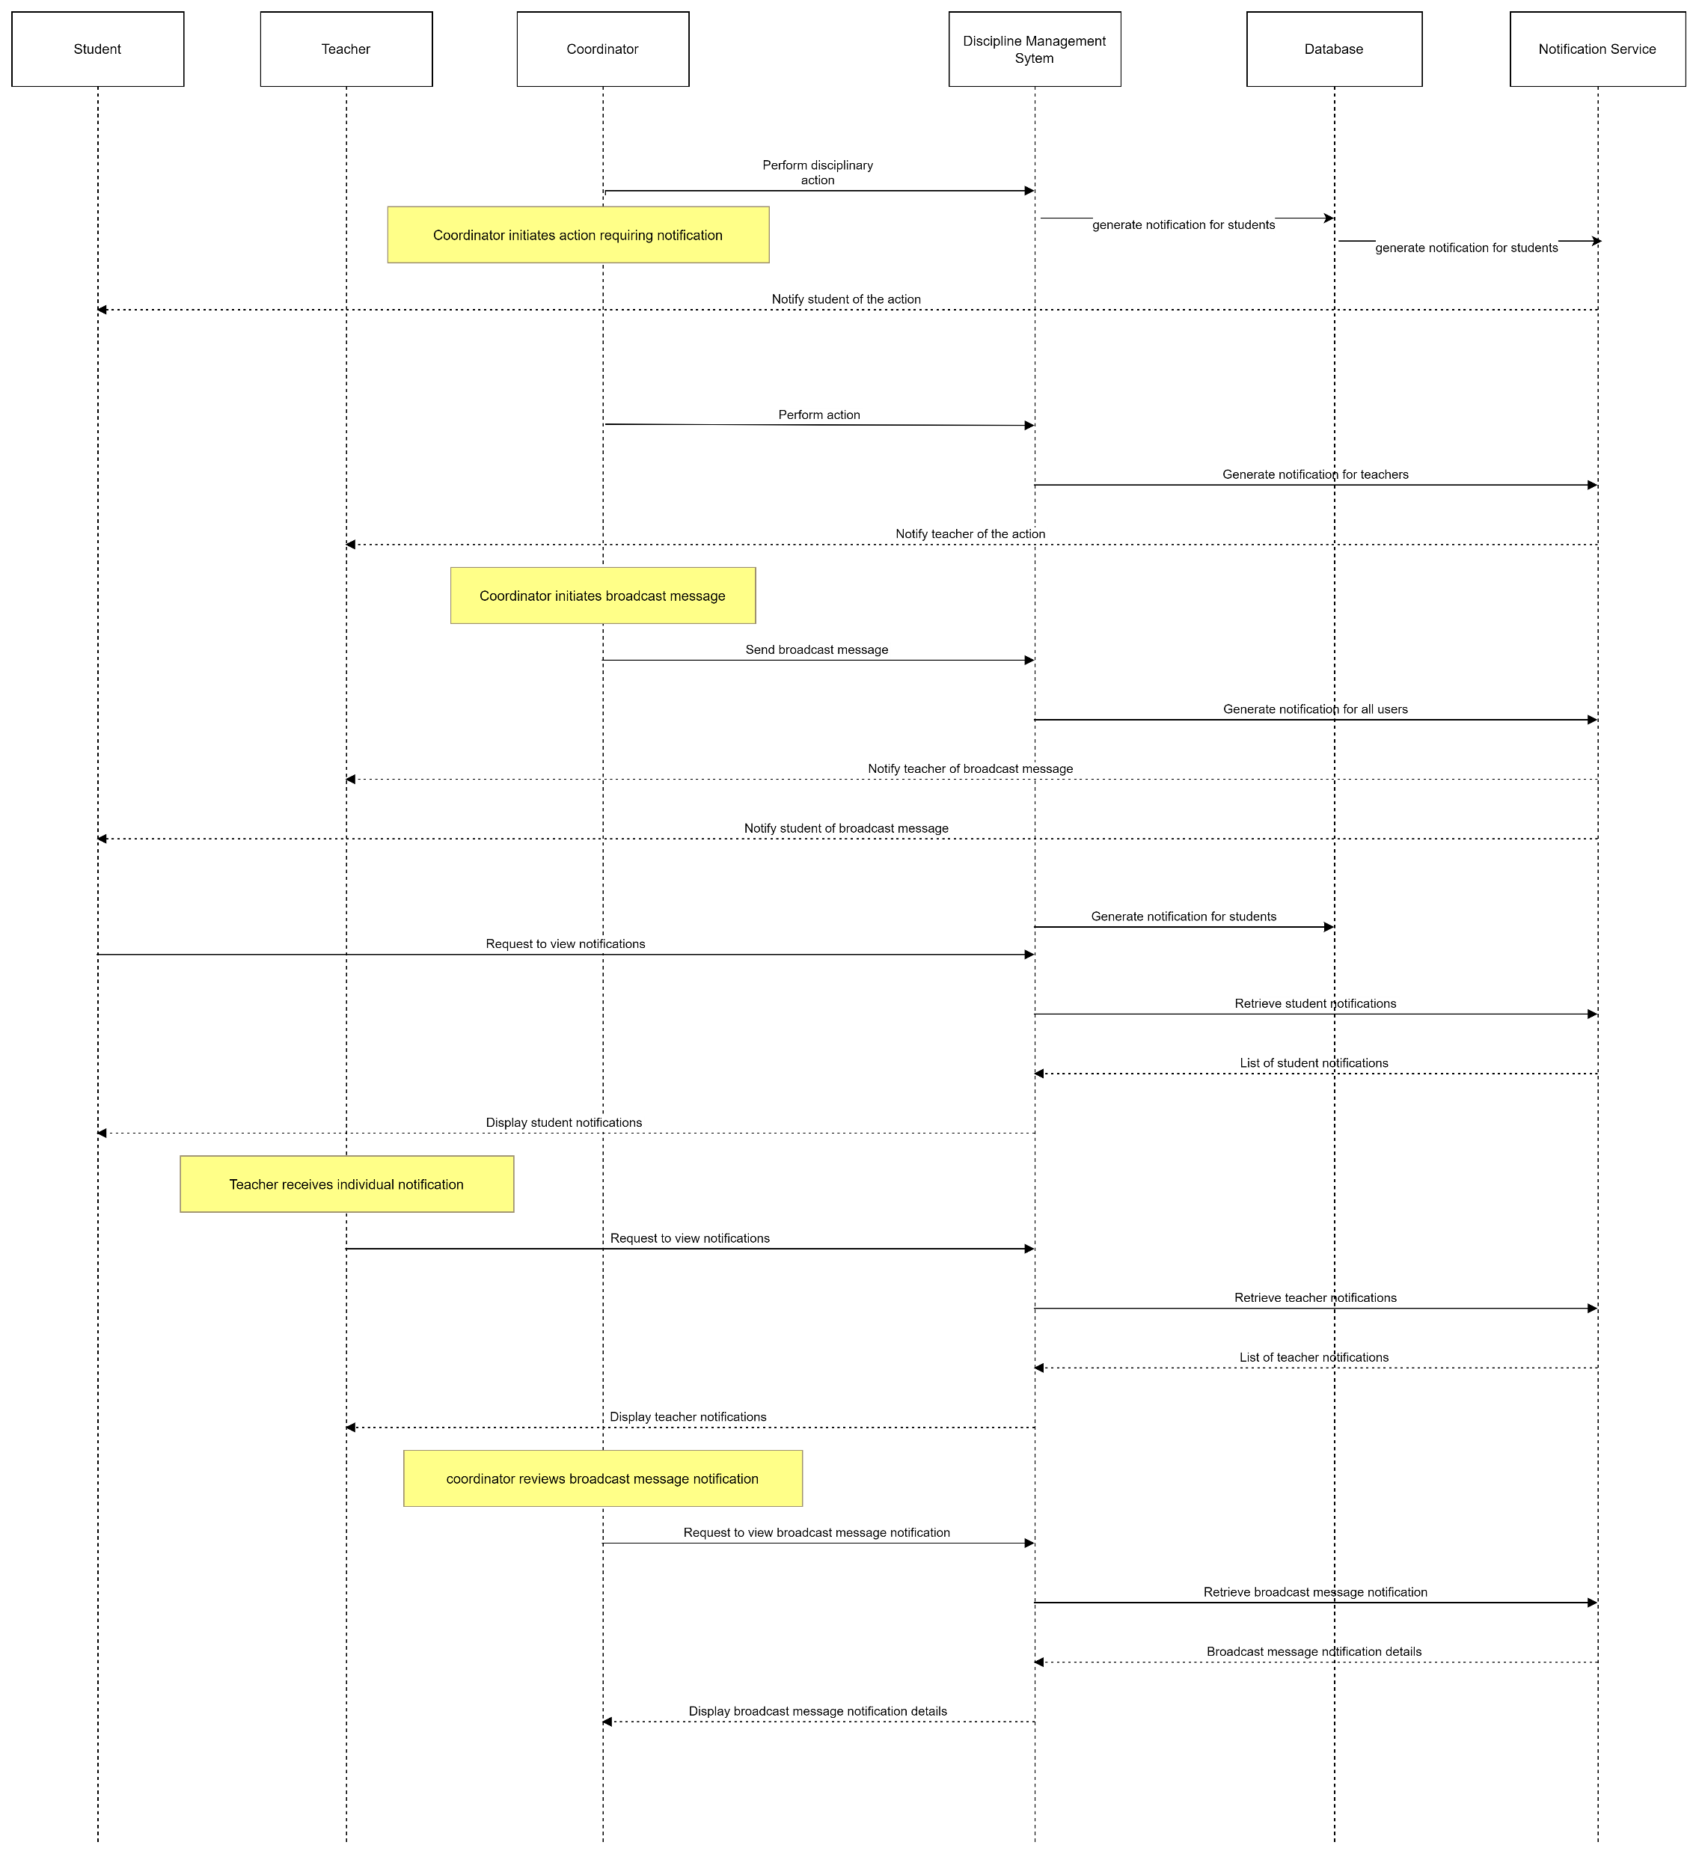
Notification system.

Slide 19
DURATION.
1 Month.

Slide 20
END.

